Slide 1
Customer Churn Classification Using Machine Learning
Student: Monepha Mitchell
Course: ITAI 1371 – Machine Learning
Professor : Viswanatha Rao

Slide 2
Project Overview
My final project focused on predicting customer churn for a telecommunications company. Customer churn occurs when a customer stops using a company’s services. I used a dataset containing 7,043 customer records and information about customer accounts, contracts, services, and billing. The target variable was Churn, which contained two categories: Yes and No. The main goal was to compare several machine-learning models and determine which model could most effectively identify customers who were likely to leave.

Slide 3
Methodology
Data Preparation
The dataset contained 7,043 customer records. During cleaning, the TotalCharges column was converted from text to numerical values, and 11 missing entries were replaced with zero because those customers had zero months of tenure. The customerID column was removed because it was only an identifier and did not provide useful information for predicting churn.
Feature Engineering and Data Split
Two new features were created. TenureGroup organized customers based on how long they had remained with the company, while NumberOfServices counted the services used by each customer. The completed dataset was divided into 70% training data, 15% validation data, and 15% testing data using stratification.
Model Development
Numerical features were standardized, categorical features were one-hot encoded, and RandomOverSampler was applied only to the training data to address class imbalance. Six classification models were trained and compared: Logistic Regression, Decision Tree, Random Forest, Gradient Boosting, K-Nearest Neighbors, and Support Vector Classifier. An Average Ensemble and a Bayesian Ensemble were also created using the strongest individual models.
Process Flow: Data Cleaning → Feature Engineering → 70/15/15 Split → Preprocessing → Class Balancing → Model Training → Validation Comparison → Final Test Evaluation

Slide 4
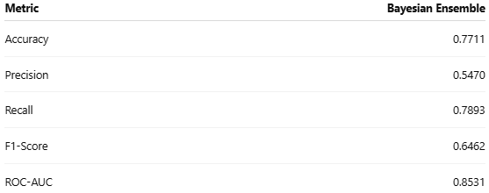
Model Results
Gradient Boosting was the strongest individual validation model, producing a ROC-AUC of 0.8376 and an F1-score of 0.6369. The Average Ensemble and Bayesian Ensemble performed similarly, showing that the strongest individual models produced consistent predictions.
Final Test Performance
The Bayesian Ensemble achieved the strongest overall test result. It combined predictions from Gradient Boosting, Random Forest, and Logistic Regression.
Key Finding
The Bayesian Ensemble correctly identified approximately 79% of customers who churned. It produced the highest test ROC-AUC and the best balance between accuracy, precision, recall, and F1-score.
Best Individual Model: Gradient BoostingBest Overall Model: Bayesian Ensemble
Weakest Model: K-Nearest Neighbors

Slide 5
Conclusion and Reflection
Conclusion
This project showed that machine-learning models can use customer account, service, contract, and billing information to identify customers who are likely to churn. The Bayesian Ensemble produced the strongest final performance, with a test ROC-AUC of 0.8531 and recall of 0.7893. Its high recall means it identified most customers who actually left the company.
Limitations and Improvements
The project used selected model settings rather than a full hyperparameter search, and RandomOverSampler balanced the training data by duplicating minority-class records. Future improvements could include hyperparameter tuning, SMOTE, probability calibration, and testing different classification thresholds based on the cost of customer-retention efforts.
Reflection
This project helped me understand the importance of cleaning data before modeling, preventing data leakage, and using separate training, validation, and test sets. I also learned that accuracy alone is not enough for an imbalanced classification problem. Comparing precision, recall, F1-score, and ROC-AUC provided a clearer understanding of each model’s performance.
Final Recommendation
Use the Bayesian Ensemble to rank customers by churn risk and support targeted retention decisions.

